Slide 1
SCC201: DATABASES
Week 7: Records and Physical Storage
By
Uraz C Turker

Slide 3
From you

Slide 4
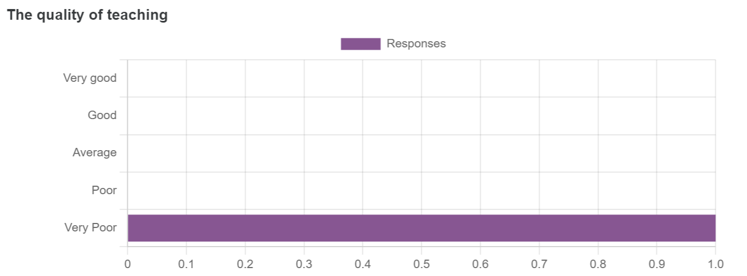
From you

Slide 5
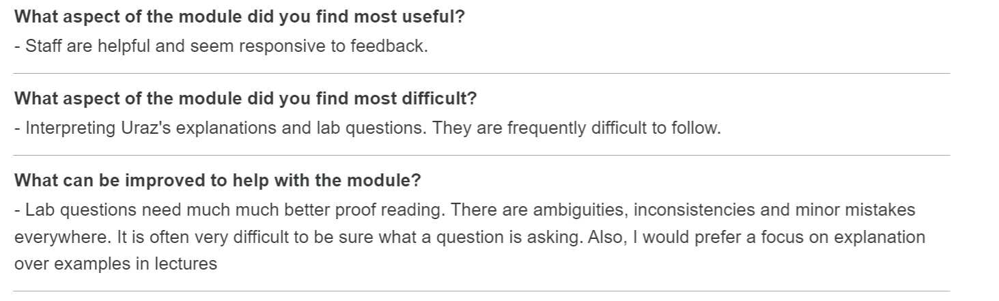
From you

Slide 6
From you

Slide 7
From you

Slide 8

From you

Slide 9
Why one example is not sufficient: “Multiplication operator”
operand1 * operand2 = result.
7 * 16 = 112
7 + 7 + 7 + 7 + 7 + 7+ … + 7 =
14 + 14 + 14 + …. + 14=
+ . +. +….
=112
How about other types of operands
Natural Numbers
Real Numbers (1.2234622354 * 234.5532)
Imaginary Numbers (a+ib * c + ik)
Matrix Multiplication

Slide 10
From you

Slide 11
From you

Slide 12
Learning outcomes
At the end of this week, you should be able to:
Describe how files and records can be placed on disks, and the effective ways in which records can be organised in files.
Describe several different types of indexes commonly found in modern database environments.
Understand the data structures which can support the various indexes.
Be fully aware of the proper ways in which indexes are used.
Use standard SQL syntax to create and remove different types of indexes on a set of tables.
Be aware of the typical approaches used in industry and commerce to improve database performance through indexing.

Slide 13
From Tuples to Records
Database content is organised on disk (we will see) as Files.
Files are ‘logically’ partitioned into Pages.
So, tuples of a relation are kept by Pages as records.
A Page is an abstraction for disk management and contains records (i.e., tuples). However, higher levels consider Records but not pages!

Slide 14


A file ‘logically’ partitioned into pages
A File
Page1
Page2
Page3
……

Slide 15
A file ‘logically’ partitioned into pages
Records are grouped in pages.
The size of a page is fixed and determined by OS/RAM
Page1
Page2
Page3
Page4
Page5
Page6
Page7
……
PageK

Slide 16
From Tuples to Records
A record is a collection of related data items, i.e., values.
e.g. Personnel record may contain forename, surname, DOB, NI number etc.
The value of each attribute can be given by one or more bytes.
Each data item (value) corresponds to a particular field/attribute of the record
Forename | Surname | DOB | NI_No | Salary
Susan | Smith | 27/04/1989 | ND783674V | 48,500
Jo | Kerr | 16/11/1995 | BH478256T | 39,000

Slide 17
Higher levels consider “Files have records”
A record is a collection of field/attribute names and their corresponding DOMAIN
Domains of attributes are standard data types such as integer, float, character strings, date, etc.
Number of bytes required to store data items of each particular domain of fixed for a given computer system
Forename | Surname | DOB | NI_No | Salary
String | String | Date | Char[9] | Float

Slide 18
Higher levels consider “Files have records”
Types of Records:
Fixed length records – every record in the file is exactly the same size (in bytes)
Variable length records – file contains records of differing lengths

Slide 19
Fixed length records
Consider a pal_stats record from PalWorld.
If an INTEGER has a defined length of 4 bytes, a record can be held in a known, fixed (44) number of bytes:
id [4] |  |  |  | stats/hp [4] |  |  |  | stats/attack/melee [4] |  |  |  | stats/attack/ranged [4] |  |  |  | stats/defense [4] |  |  |  | stats/speed/ride[4] |  |  |  | stats/speed/run[4] |  |  |  | stats/speed/walk [4] |  |  |  | stats/stamina [4] |  |  |  | stats/support [4] |  |  |  | stats/food [4]

Slide 20
Fixed length records
Record id = <pageId,slotNumber>
The starting byte position of each field/attribute can be identified relative to the start of a record
Similarly, the start position of the next record can be identified relative to the position of the current record (to calculate the slot number)
0 |  |  |  | 4 |  |  |  | 8 |  |  |  | 12 |  |  |  | 16 |  |  |  | 20 |  |  |  | 24 |  |  |  | 28 |  |  |  | 32 |  |  |  | 36 |  |  |  | 40
id [4] |  |  |  | stats/hp [4] |  |  |  | stats/attack/melee [4] |  |  |  | stats/attack/ranged [4] |  |  |  | stats/defense [4] |  |  |  | stats/speed/ride[4] |  |  |  | stats/speed/run[4] |  |  |  | stats/speed/walk [4] |  |  |  | stats/stamina [4] |  |  |  | stats/support [4] |  |  |  | stats/food [4]
0 |  |  |  | 4 |  |  |  | 8 |  |  |  | 12 |  |  |  | 16 |  |  |  | 20 |  |  |  | 24 |  |  |  | 28 |  |  |  | 32 |  |  |  | 36 |  |  |  | 40 |  |  |  | 44
id [4] |  |  |  | stats/hp [4] |  |  |  | stats/attack/melee [4] |  |  |  | stats/attack/ranged [4] |  |  |  | stats/defense [4] |  |  |  | stats/speed/ride[4] |  |  |  | stats/speed/run[4] |  |  |  | stats/speed/walk [4] |  |  |  | stats/stamina [4] |  |  |  | stats/support [4] |  |  |  | stats/food [4] |  |  |  | Id[4]

Slide 21
How are fixed-length records kept in a page?
Slot 1
Slot 1
Record id = <pageId,slotNumber>
Slot 2
Slot 2
. . .
Free
Space
. . .
Slot N
Slot N
Slot M
N
1
. . .
1
1
0
M
number
of records
M ... 3 2 1
number
of slots
PACKED
UNPACKED, BITMAP
In the first alternative, the first N slots are for records. Moving records for free space management will change the Record ID, which may not be acceptable.
In the second alternative, we use a bitmap to track the free space.
Notes:
11

Slide 22
Variable length records
Different records in a file may have different sizes in bytes for several reasons
Records of the same record type but have one or more varying length attributes (e.g. TEXT domain with no character limit)
Records of the same type but an attribute may have multiple values for a record (e.g. multiple contact phone numbers)
Records of the same type but one or more attributes may be optional.

Slide 23
Variable length records
Fields/Attributes in variable length records can be terminated by a special (like *) separator character.
Other methods for encoding variable length fields may include
Fields as name/value pairs <field name, field value>
Field length (in bytes) can be stored preceding field value
B | O | B | * | S | M | I | T | H | * | 1 | 9 | 8 | 6 | - | 0 | 8 | - | 2 | 3 | N | Z | 1 | 4 | 8 | 7 | 2 | 3 | B | 47000

Slide 24
How are variable-length records kept in a page?
Fields/Attributes in variable length records can be terminated by a special (like *) separator character.
Other methods for encoding variable length attributes may include
Attributes as pairs <attribute name, attribute value> pairs
Fields/Attribute length (in bytes) can be stored preceding field value
47000 | B | O | B | * | S | M | I | T | H | * | 1 | 9 | 8 | 6 | - | 0 | 8 | - | 2 | 3 | N | Z | 1 | 4 | 8 | 7 | 2 | 3 | B | …….

Slide 25
How are variable-length records kept in a page?
Rid = (i,N)
Page i
Rid = (i,2)
Rid = (i,1)
20
16
24
N
Pointer
to start
of free
space
N . . . 2 1
# slots
SLOT DIRECTORY
Can move records on page without changing rid; so, attractive for fixed-length records too.
Notes:
12

Slide 26
How are pages kept in physical storage?

Slide 27
What do we mean by physical storage?
Physical Storage is a mechanism that enables a computer to retain data, either temporarily or permanently.
Storage devices such as flash drives and hard disks are a fundamental component of most digital devices since they allow users to preserve all kinds of information, such as videos, documents, pictures and raw data.

Slide 28
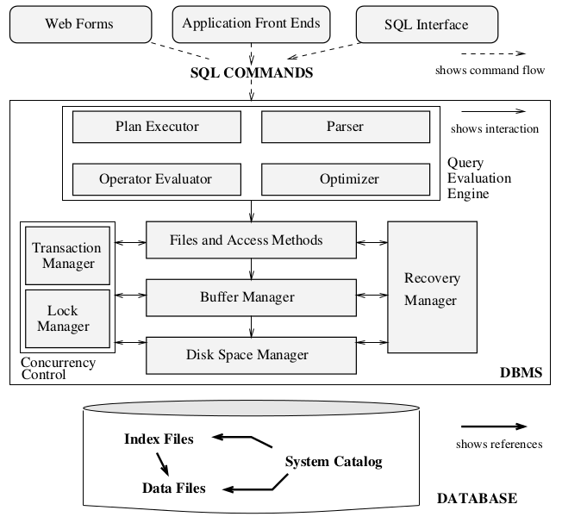
Relational DBMS Architecture
Storage
Management
Subsystem

Slide 29
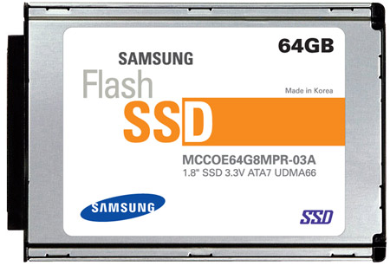
Another View of Storage Manager
Week 9
Access Methods
Sorted File
Hash Index
Concurrency Control Manager
This Week
B+-tree Index
Recovery Manager
Heap File
Buffer Manager
Week 8
I/O Manager
I/O Accesses

Slide 30
Memory/Storage Hierarchy
~MBs
~£2/MB
~100GB/s
CPU
Cache
~10GB/s
100s
Main Memory
~10GBs
~£5/GB
Price
Access Speed
Capacity
A C C E S S C Y C L E S
Non-Volatile RAM
~TBs
~£200/TB
~GB/s
10⁵ – 10⁶
Flash Storage
10⁷ – 10⁸
Magnetic Hard Disk Drive (HDD)
~10TBs
~£30/TB
~200MB/s
~50MB/s
Tape
~PBs; ~£10/TB

Slide 31
Storage of databases
Most DB data resides in secondary storage
HDD/SSD
May be too large to reside entirely in main memory (e.g. H-Unique core datasets > 250GB and will grow to several TB)
Secondary storage costs orders of magnitude lower than main memory but slower to access
Often, not all database data is required frequently – access from disk as required
Secondary storage offers persistence
Trade-off between storage capacity, robustness and speed of access
Physical access characteristics affect access latency and transfer rate of data

Slide 32
Storage of databases
Main memory DBs do exist
Entire database held in main memory (along with OS, DBMS and possibly other applications)
Suited for real-time applications requiring extremely fast response times
E.g. Telephone network routing, high-frequency trading
Extremely expensive for large datasets
Many (most?) applications do not require this level of response
Beyond scope of this module

Slide 33
Components of a Disk

Slide 34
Components of a Disk
1 block = n contiguous sectors
(n fixed during disk configuration)

Slide 35
How does a Disk Work?
Magnetic changes on platters to store bits
Spindle rotates platters
7200 to 15000 RPM
(Rotations Per Minute)
The head reads/writes track
Exactly 1 head can read/write at a time
The arm moves radially to position head on track

Slide 36
How is the Disk Integrated?
OS interfaces
with the
Disk Controller

Slide 37
Let’s start

Slide 38


Slide 39
Advertisement
Quantum Search for AI
Quantum Search for Software Testing
You will implement a quantum algorithm to accelerate the Q-Graph framework (invented by Turker et al) using the Groover’s algorithm.
You will implement a quantum algorithm to accelerate the Software Test Generation approaches from mathematical representations of Software Systems. (invented by Turker et al.) using the Groover’s algorithm.

Slide 40

Advertisement
Explainable UAV Control
Explainable Car Control
You will implement a Q-Graph framework (invented by Turker et al) to control UAV.
You will implement a Q-Graph framework (invented by Turker et al) to control a model car.

Slide 41


LECTURE

Slide 42
What we did in last lecture?
Tuples to records
Records size is decided by
The domains (data type) of its attributes and
The system-specific memory space requirements of these data types.
Two types of records
Fixed length
Variable length
File is the fundamental memory abstraction for disk drives.
File is partitioned into pages.
Records are allocated to pages using
Packed
Unpacked (bitmap)
HD has platters, each divided into sectors and (logical) cylinders.

Slide 43
What we did in last lecture?
Access time = Rotational delay + Seek time + Transfer time
Seek time
Moving disk head to correct track
Typically, 1-20ms (high-end disks: avg is 4ms)
Rotational delay
Waiting for the sector to come under disk head
Function of RPM; typically, 0-10ms (avg v worst)
Transfer time
Moving data from/to the disk surface
Typically, hundreds of MB/s!

Slide 44
Question
A file has r= 150,000 Player Records of fixed length; each record has the following attributes
ID# 4 BYTES, NAME 12 BYTES, ADDRESS 45 BYTES, CHARACTER_ID# 4 BYTES,
Calculate the record size R,
Calculate the bfr if the block size is 512 bytes,
Calculate the number of tracks if the block is 512 bytes, # of blocks per track is 20.

Slide 45
Typically, hundreds of MB/s!
Is it possible to exploit RAM better and avoid going to disk all the time?

Slide 46
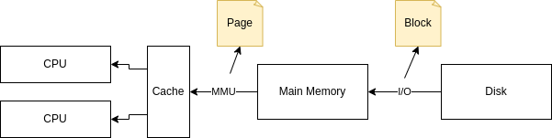
Buffer Management
Buffer pool
Pages should be in DRAM for DBMS query processor
But not all pages of a database might fit in DRAM!
Buffer Pool
A part of the main memory that DBMS manages
Divided into buffer frames (slots for pages)
Buffer Manager
Subsystem of DBMS to read pages from disk to buffer pool and write “dirty” pages back to disk

Slide 47
Buffer Manager manages buffer pool
Page Requests from Higher Levels and
say scan on a file with 1 million pages
BUFFER POOL
dirty
page/frame
free frame
MAIN MEMORY
DISK
choice of frame dictated
by replacement policy
DB
Data must be in RAM for DBMS to operate on it!
Buffer manager holds
Table of <frame#, pageid> pairs is maintained.
Pin_count bit = number of users of that page
Dirty bit= indicates whether the page is modified or not
Notes:
4

Slide 48
PC and DB bits.
2 variables per buffer frame maintained
Pin Count
Current number of “users” of the page in the frame
“Pinning” means PinCount++; page requested
“Unpinning” means PinCount is 0; page released
Dirty Bit
Set when a user notifies that the page was modified
Must write this page back to disk in due course!
Q: What if 2 users pin and modify the same page?!

Slide 49
Handling Page Requests
Choose a frame for replacement (buffer replacement policy); it should have a PIN count of 0!
If the chosen frame has Dirty Bit set, “flush” it to the disk.
Read the requested page into the chosen frame.
Pin the page and return the frame address
Is page in
buffer pool?
No
Yes
Return address of the frame in the pool
Increment Pin Count

Slide 50
Buffer Replacement Policy
Policy to pick the frame for replacement
Has a major impact on I/O cost (number of disk I/Os) of a query based on its data access pattern
Popular policies:
Least Recently Used (LRU)
Most Recently Used (MRU)
“Clock” (LRU variant with lower overhead)
First In First Out (FIFO), Random, etc.

Slide 51
Least Recently Used (LRU)
Queue of pointers to frames with PinCount of 0
Add newly unpinned frame to end of queue
For replacement, grab frame from front of queue
5 pages on disk:
A, B, C, D, E
Example:
3 frames in pool
Page request sequence:
Request A, Request B, Modify A, Request D,
Release B, Release A, Request E, Request C,
Release C, Release D, Release E

Slide 52
Least Recently Used (LRU)
Buf. Pool
Release B
Release A
F0 | F1 | F2
Page
- | - | -
0 | 0 | 0
0 | 0 | 0
A | B | D
1 | 0 | 1
1 | 0 | 0
A | B | D
0 | 0 | 1
1 | 0 | 0
PC
DB
and so on
Request A
Request D
Request E
Release C
A | - | -
1 | 0 | 0
0 | 0 | 0
A | B | D
1 | 1 | 1
1 | 0 | 0
A | E | D
0 | 1 | 1
1 | 0 | 0
C | E | D
0 | 1 | 1
0 | 0 | 0
Request B
Modify A
Request C
Flush A!
A | B | -
1 | 1 | 0
0 | 0 | 0
A | B | -
1 | 1 | 0
1 | 0 | 0
C | E | D
1 | 1 | 1
0 | 0 | 0
What happens if I request page A again?
F2
Queue of pointers:
F0
F1
F0

Slide 53
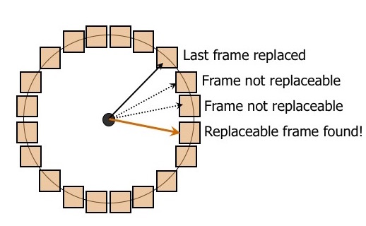
Clock Algorithm (Second Chance)
Variant of LRU with lower overhead (no queue)
N buffer frames treated logically as a circle: the “clock”
The current variable points to a frame: the “hand”
Each frame has a Referenced Bit (along with PC, DB)
Finding a frame to replace:
If PC > 0, RB=1 and increment the Current
If PC == 0 :
If RB == 1, set its RB = 0 and increment Current
If RB == 0, pick this frame!
If DB is set, flush the page.

Slide 54
Sequential Flooding: requesting new pages one after another.
LRU performs poorly when file is repeatedly scanned
Given: Num. buffer frames < Num. pages in file
Then, every page request causes a disk I/O!

Slide 55
The problem is that we can’t allocate the whole DB into RAM.
Techniques for storage of large amounts of data are essential to understand:
Database designers and administrators need to consider the advantages and disadvantages of each technique
Physical database design involves selecting appropriate organisation techniques to choose for specific application requirements – domain knowledge as well as technical knowledge needed!
DBMS designers must provide efficient implementations of physical data organisation techniques for database designers and admins.

Slide 56
Page vs Block
Recall that from the DBMS designer’s point of view, disk space is organized into files, each having pages that hold records.
From the hardware designer’s point of view, each page is physically laid out on 1 or more disk blocks (set of sectors on a track).
Typical block size: 512B; page size: 4KB or 8KB
OS/RAM page size is not necessarily the same as the disk block
Page size is always a multiple of disk block size but can be much higher, e.g., even 1 MB
Page is DBMS's basic unit of reads/writes to disk.
File data (de-)allocated in increments of pages on disk.

Slide 57
Disk Data Layout Principles
Access time = Rotational delay + Seek time + Transfer time
Sequential access vs. Random access
Reading contiguous blocks together amortises seek time and rotational delay.
For a transfer rate of 200MB/s, sequential reads can be ~200MB/s, but random reads ~0.3MB/s.
Better to lay out pages of a file contiguously on disk.
“Next” block concept (Key to lower I/O cost: reduce seek/rotation delays!):
On the same track (in rotation order), then the same cylinder, and then the adjacent cylinder

Slide 58
Interpretation of a file: from DBMS to Hardware
A File
Page1
Page2
Page3
Page4
Page5
Page6
Page7
……
PageK

Slide 59
Interpretation of a file: from DBMS to Hardware
A File
Page1
Page2
Page3
DISK BLOCK
DISK BLOCK
DISK BLOCK
DISK BLOCK
Page4
Page5
Page6
Page7
……
PageK

Slide 60
Interpretation of a file: from DBMS to Hardware
A File
DISK BLOCK 1
DISK BLOCK 3
DISK BLOCK 2
DISK BLOCK 4

Slide 61
Interpretation of a file: from DBMS to Hardware
A File
DISK BLOCK 1
DISK BLOCK 3
FILE BLOCKs
DISK BLOCK 2
DISK BLOCK 4

Slide 62
Allocating Files On Disk Blocks
Database files typically have an initial allocation on disk blocks
As data growth occurs (and it nearly always does!) files need to grow to accommodate the enlarged data.
Block allocation routines need to balance performance, flexibility and space efficiency
Two considerations
Ease of growing the file
Access time

Slide 63
Allocating File Blocks On Disk
Continuous allocation
Files occupies consecutive disk blocks
Empty disk block
DB file block
Used disk block
File growth space
+ve: Very fast reading of whole file as blocks are contiguous
-ve: File expansion difficult due to used blocks on disk

Slide 64
Allocating File Blocks On Disk
Linked allocation
Each file distributed to disk blocks via a linked list
Empty disk block
DB file block
Used disk block
File growth space
+ve: Very easy to expand file, just allocate next free block and add a pointer
-ve: File reads are slower, especially with magnetic disks

Slide 65
Allocating File Blocks On Disk
Cluster allocation
Combines continuous and linked allocations
Allocate clusters of blocks and link them with pointers
Empty disk block
DB file block
Used disk block
File growth space
Achieves a balance between ease of expansion and read performance

Slide 66
Allocating File Blocks On Disk
Indexed Allocation
One or more index blocks contain pointers to actual file blocks
Empty disk block
DB file block
Used disk block
Index Block
Read index blocks to find pointers to blocks containing desired data
Analagous to using a library card index
Indexing covered late.

Slide 67
Next?
Now we have a file and a set of file blocks.
The question is, how are we supposed to store our records within these file blocks?
How do we split file blocks (record blocking) for records?
How do we order the records?

Slide 68
Record blocking & disk storage
B > R
B < R
B = R
Records of a file must be allocated to file blocks
Suppose the block size is B bytes, and a file contains fixed length records of size R bytes
If B > R we can fit bfr = ⎣B / R⎦ records per block
bfr is known as the blocking factor
Floor function = ⎣(x)⎦ rounds the number x down to an integer
Thus ⎣12.7⎦ = 12
R may not divide B exactly.
There will be unused space in each block equal to B- (bfr * R) bytes

Slide 69
Record blocking: Spanned vs Unspanned
If a block does not have enough remaining space to store the complete record, the situation may be handled in one of two ways:
Spanned records may be spread across two blocks; the first block has a pointer to the block containing the rest of the record
Otherwise, it is Unspanned, i.e. cross-block reference is not allowed.
Block i
Record 1 | Record 2 | Record … | Rec | >
ord 1934 | Record 1935 | Record 1936 | Record 1937 | >
Block i + n
Block i
Record 1 | Record 2 | Record 3 | Empty
Record 4 | Record 5 | Record 6 | Empty
Record 7 | Empty
Block i + n
Block i + k
Block i + k

Slide 70
What we did?
We have a file; we allocated the file to disk blocks and obtained file blocks.
We decided on the allocation method for our records (spanned or unspanned).
Now, what do we need to do?
We need to decide on the order of our records..

Slide 71
How should we need to order our records within these disk blocks?
Record 1 | Record 2 | Record 3 | Empty
Record 4 | Record 5 | Record 6 | Empty
Record 7 | Empty
Record 3 | Record 4 | Record 5 | Empty
Record 2 | Record 1 | Record 6 | Empty
?
Record 1 | Record 5 | Record 6 | Empty
Record 3 | Record 4 | Record 2 | Empty

Slide 72
File organisation
Primary file organisation (Actual data)
How actual records are ordered
Determines how records are accessed
Secondary file organisation (Data allowing fast access)
How do we access our data
Efficient access to records
E.g. index structures (covered next week)
Relational algebra is very powerful, right?
We may generate queries that relate to different attributes.
So, no preset ordering will be sufficient…

Slide 73
The big picture
Primary Organisation
How is the actual data kept on disk
Heap files
Ordered Files
Additional files that keep pointers to
reach records/disc blocks efficiently
Secondary files
Multi Level-Indexes
Single-level Index
Primary Index
Cluster Index
Secondary Index

Slide 74
Primary organisation: Unordered (Heap) Files
Also known as heap files
Simplest most basic type of organisation
Records placed in file in insertion order
New records placed at end of file
Inserting new record very efficient
Address of last block kept in file header
Last file block copied to buffer
New record added and written to disk

Slide 75
Primary organisation: Unordered (Heap) Files
Searching for records is very expensive
Linear search required
Deletion of record expensive and inefficient
Linear search to find the block with the record to be deleted
Copy block (page) to buffer
Delete the record within the block while the block is in the buffer.
Rewrite block to disk
Leaves unused space on disk
Large no. of deletes leads to much wasted space

Slide 76
Primary organisation: Unordered (Heap) Files
Alternative deletion approach
Use deletion marker
Extra bit set to mark records as deleted
Search operations ignore deleted records
Unordered records require periodic file reorganisations to reclaim unused space

Slide 77
Implementation of Heap Files: 1 Linked Lists
Data
Page
Data
Page
Data
Page
Full Pages
(Filename, Header PageID) stored in known catalog
Each page has 2 pointers (PageIDs) and data records
Pages in second list have some free space
Header
Page
Data
Page
Data
Page
Data
Page
Pages with
Free Space

Slide 78
Implementation of Heap Files: 2 Page Directory
Data
Page 1
Header
Page
Data
Page 2
Entry in a directory for each page:
Is it free or full?
How many bytes of free space?
Faster to identify page with free space to add records
Data
Page N
Directory

Slide 79
Primary organisation: Ordered Files
Physically order records in a file based on one of their fields/attributes (called ordering field/attribute)
Ordering attribute called ordering key if it is a key (a candidate key) field of the file
i.e. unique value for each record
Non-key attributes can also be used to order.
Clustering. The attribute used to cluster is called the clustering field

Slide 80
Primary organisation: Ordered Files
Ordering Key
Surname | Forename | DOB | NI_No | Salary
Abdelfattah | Mahmoud
Abd Majid | Wardina
Addo | Stephen
Block 1
Surname | Forename | DOB | NI_No | Salary
Zhang | Jiarui
Zhu | Jerry
Zou | Jiehan
Block n

Slide 81
Clustering order,
Main Data File
Name | Contact_No | DOB | Salary
*********** | *********** | *********** | 30,000
*********** | *********** | *********** | 30,000
*********** | *********** | *********** | 30,000
*********** | *********** | *********** | 35,000
Clustering Field
*********** | *********** | *********** | 35,000
*********** | *********** | *********** | 40,000
*********** | *********** | *********** | 40,000
*********** | *********** | *********** | 40,000
*********** | *********** | *********** | 40,000
*********** | *********** | *********** | 40,000
*********** | *********** | *********** | 50,000
*********** | *********** | *********** | 50,000
81
*********** | *********** | *********** | 60,000
*********** | *********** | *********** | 60,000

Slide 82
Binary search example
Find the element with value 76
Middle element less than search value : Search upwards
Target item located after 3 steps – linear search would take 19
1 | 3 | 6 | 8 | 11 | 21 | 26 | 32 | 35 | 39 | 40 | 41 | 46 | 49 | 52 | 58 | 63 | 72 | 76 | 82 | 99
41 | 46 | 49 | 52 | 58 | 63 | 72 | 76 | 82 | 99
63 | 72 | 76 | 82 | 99

Slide 83
Primary organisation: Ordered Files
+ve:
Reading records in an order defined by key extremely efficient
No sorting required
Finding the next record in order requires no additional block access unless the current record is in the last block
Using search conditions based on ordering key results in faster access

Slide 84
Primary organisation: Ordered Files
+ve:
Reading records in an order defined by key extremely efficient
No sorting required
Finding the next record in order requires no additional block access unless the current record is in the last block
Using search conditions based on ordering key results in faster access

Slide 85
Primary organisation: Ordered Files
+ve:
Reading records in an order defined by key extremely efficient
No sorting required
Finding the next record in order requires no additional block access unless the current record is in the last block
Using search conditions (SELECT NAME FROM STUDENTS WHERE ID =1177) based on ordering key results in faster access

Slide 86
Primary organisation: Ordered Files
Surname | Forename | DOB | NI_No | Salary
Abdelfattah | Mahmoud
Abd Majid | Wardina
Addo | Stephen
-ve:
No advantage for access based on values of non-ordering fields
Insertion and deletion of records are very expensive
Records must remain physically ordered
e.g. insert:
Find the correct position in the file
Make space and insert record
Costly operation for large files
Modification of a record
Record may change position in file > equivalent to deletion + insertion

Slide 87
Primary organisation: Ordered Files
Surname | Forename | DOB | NI_No | Salary
Abdelfattah | Mahmoud
Abd Majid | Wardina
Addo | Stephen
-ve:
No advantage for access based on values of non-ordering fields
Insertion and deletion of records are very expensive
Records must remain physically ordered
e.g. insert:
Find the correct position in the file
Make space and insert record
Costly operation for large files
Modification of a record
Record may change position in file > equivalent to deletion + insertion

Slide 88
Primary organisation: Ordered Files
Surname | Forename | DOB | NI_No | Salary
Abdelfattah | Mahmoud
Abd Majid | Wardina
Addo | Stephen
-ve:
No advantage for access based on values of non-ordering fields
Insertion and deletion of records are very expensive
Records must remain physically ordered
e.g. insert:
Find the correct position in the file
Make space and insert record
Costly operation for large files
Modification of a record
Record may change position in file > equivalent to deletion + insertion

Slide 89
Primary organisation: Ordered Files
Surname | Forename | DOB | NI_No | Salary
Abdelfattah | Mahmoud
Abd Majid | Wardina
Addo | Stephen
-ve:
No advantage for access based on values of non-ordering fields
Insertion and deletion of records are very expensive
Records must remain physically ordered
e.g. insert:
Find the correct position in the file
Make space and insert record
Costly operation for large files
Modification of a record
Record may change position in file > equivalent to deletion + insertion

Slide 90
What is a secondary file?
Primary Organisation
Heap files
Ordered Files
Secondary files describe supplemental access structures which are used to speed up the retrieval of records when specific search conditions are met
Varying types of secondary file
Single level
Primary indexes
Clustering indexes
Secondary indexes
Multi-level
Secondary files
Multi Level-Indexes
Single-level Index
Primary Index
Cluster Index
Secondary Index

Slide 91
Secondary files
Exist in addition to our primary file organisations
Similar to indexes in textbooks. Index means “access structure”.
Provide an alternative way of locating record blocks on disk without affecting the physical placement of records on disk
Any field of a record in a file can be used to create an index
Fields used to created index are called indexing fields
Multiple indexes on different fields can be constructed for the file

Slide 92
Let’s get started

Slide 93
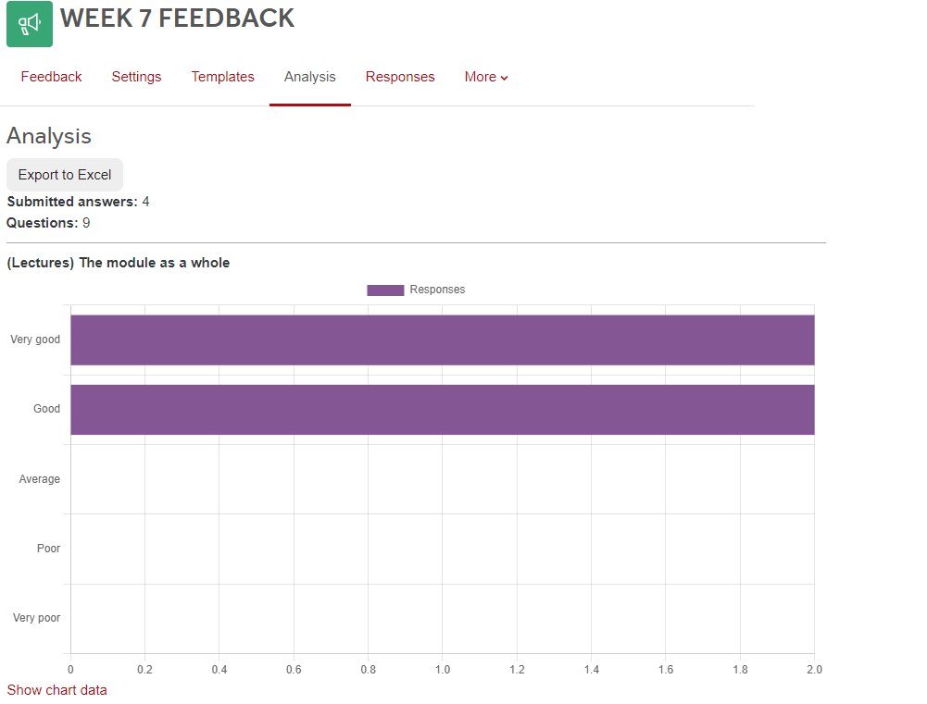
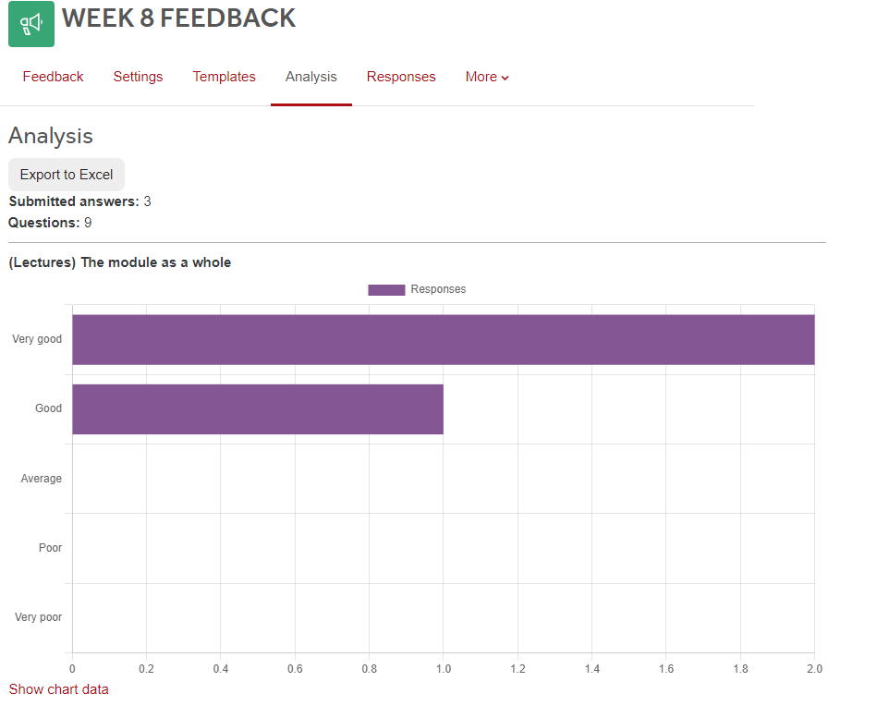
From you

Slide 94
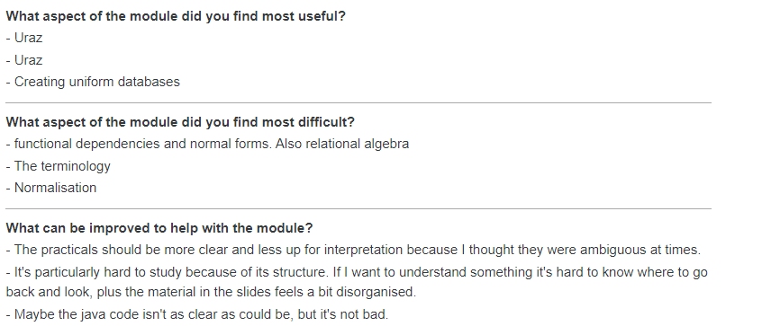

Slide 95
Please come to my office when you have time, B25 – InfoLab If I am not teaching or in a meeting, I will help you.

Slide 97
JAVA side requires initiative and creativity. But in any case, you are free to contact Uraz. ☺

Slide 99
I have updated the Moodle Page!

Slide 100
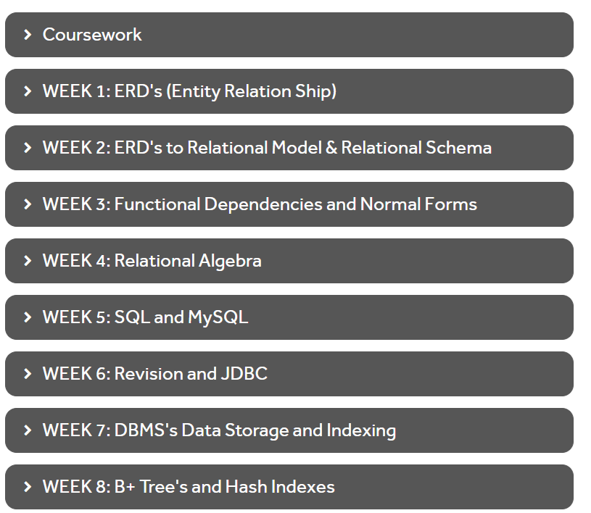

Slide 102
Agreed, I will provide more detailed comments ☺

Slide 103
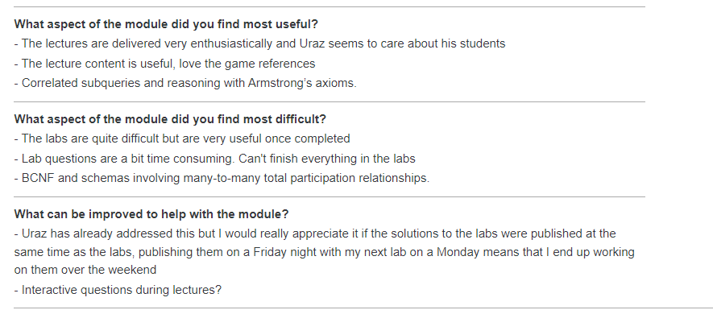

Slide 104
Some of the questions are there for you to think about and gain intellectual experience, so this is normal, no need to worry. These materials will save you during the exam/real-life problems!

Slide 106
Will do!

Slide 107



Slide 108
Lab 6 & 7 are missing will provide!

Slide 110
The teaching office will inform me about time

Slide 111
Will do!

Slide 112
Yes. Last week the order was not correct! I noticed this on the Weekend!

Slide 115
Started already (re-positioning animations)
but may take time.

Slide 116

OK, let’s be considerate for all, some of your friends need the solutions. If you do not require them, you can select not opening the files. Let’s show tolerance ☺

Slide 117

LECTURE

Slide 118
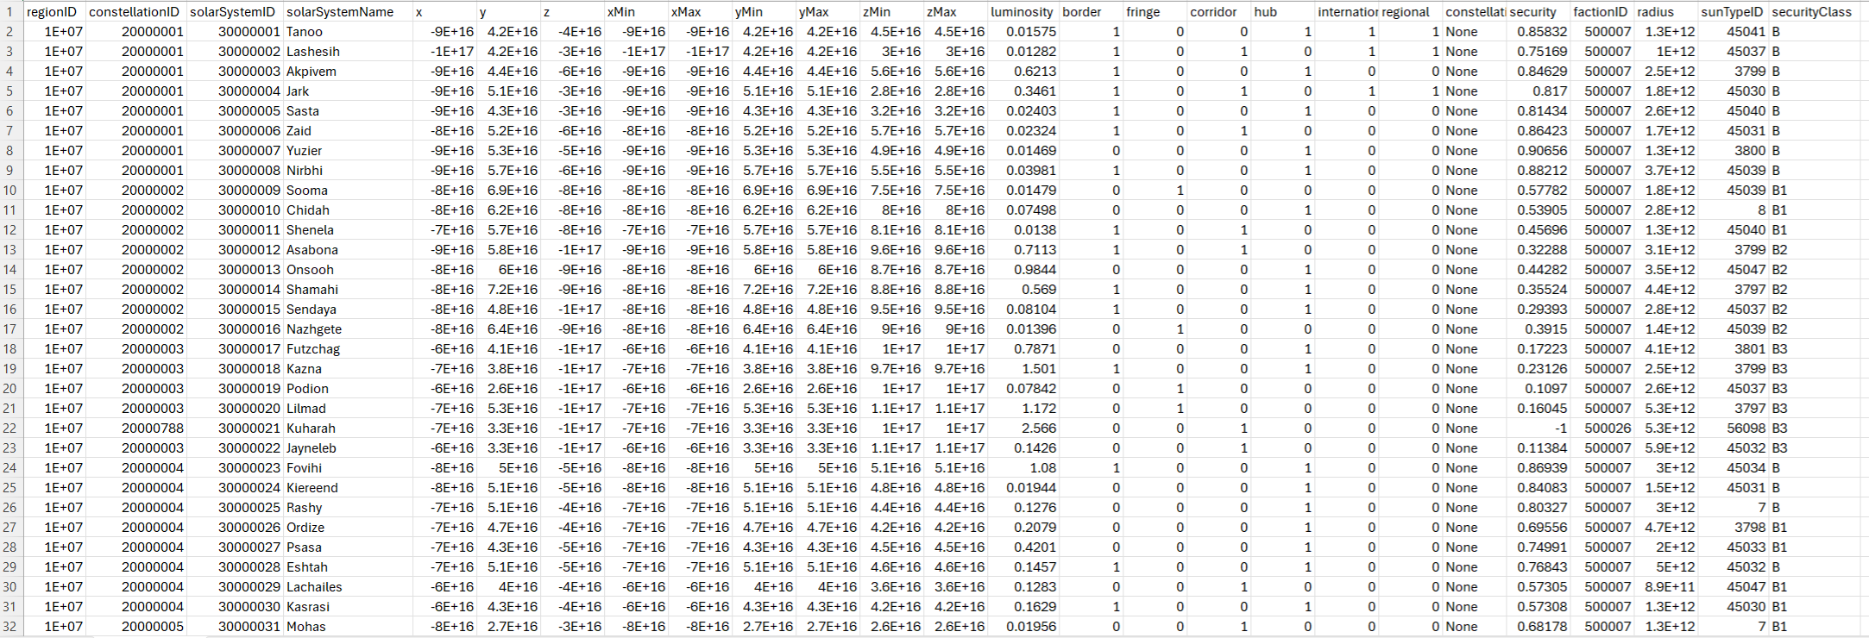
Record: Fixed Length/Variable Length

Slide 119
File

Slide 120
File
Disk Block
Disk Block
Disk Block
Disk Block
Disk Block
Disk Block
Keeping the records in files:
Ordered File Organisation or Heap File Allocation
Disk Block
Keeping the records in blocks:
Spanned record allocation or Unspanned record allocation
Disk Block

Slide 121
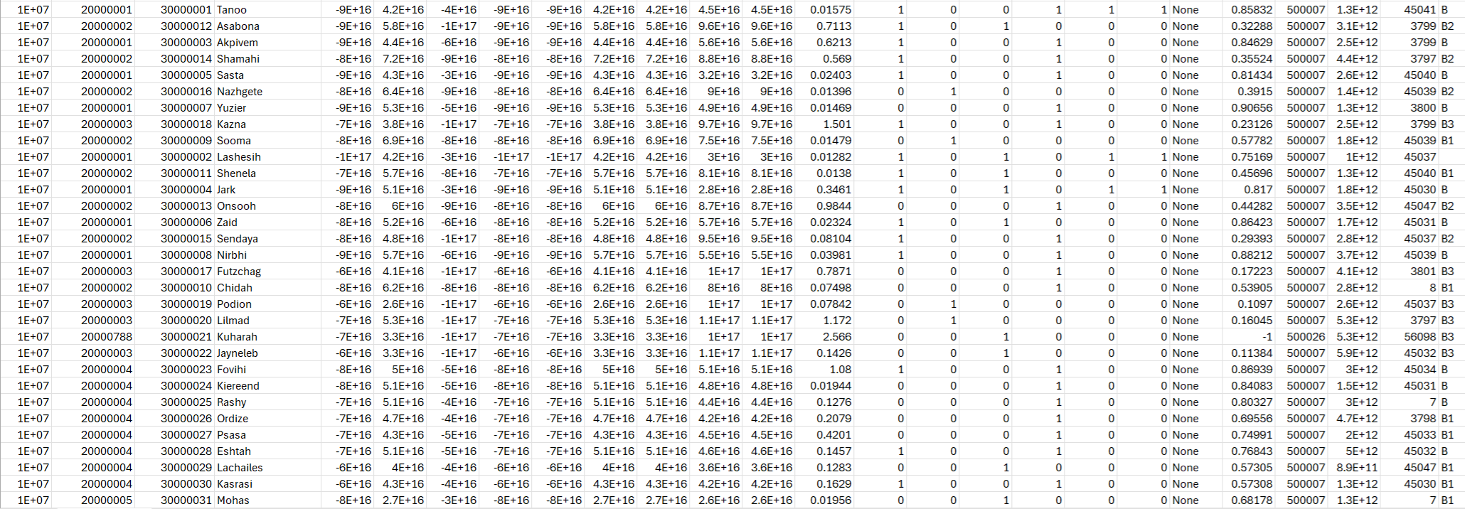
File: Heap (Unordered) Files

Slide 122
File: Sorted File – Ordering Key

Slide 123
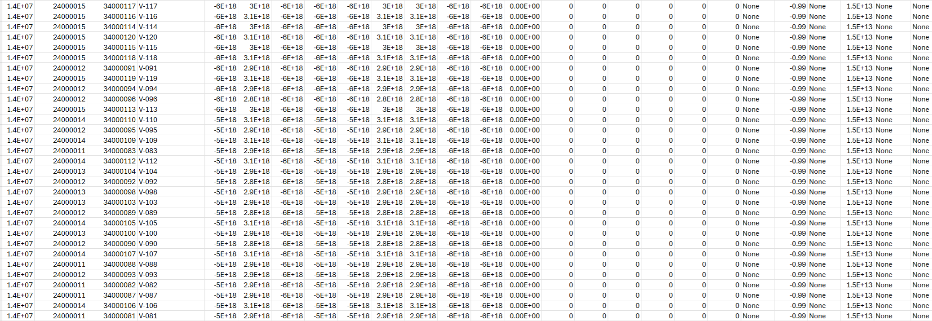
File: Sorted File-Clustering Field.

Slide 124
Fast access to records is still a problem even if we have ordered files
Disk Block
Disk Block
Disk Block
Records are kept in HDD using ordered file allocation.
Ordering can only be done w.r.t. one set of attributes (composite key).
Queries might require information irrespective of this order.
How do we fasten search?
We create Secondary Files.
Single Level Indexes
Multi-Level Indexes
Disk Block
Disk Block
Disk Block

Slide 125
Single level indexes
An index is usually a fixed-length record in the form of:
<index field (attribute), Pointer to disk-block or record itself>
Multiple types of single level indexes
Primary indexes
Clustering indexes
Secondary indexes

Slide 126
Primary Indexes

Slide 127
Primary indexes
Specified on the ordering key of an ordered file (cannot be done on heap file)
Remember: The ordering key has a unique (i.e. Primary Key) value for each record
For each block, one entry exists in the Primary Index file.
Not one entry for each record in the data file
An entry contains a primary key for the first record in a block, along with a pointer to that block
The first record in each block is called the anchor record of the block or the block anchor

Slide 128
Primary index example
Anchor Record
Main Data File (IN HDD!)
Block Anchor Key Value | Block Pointer
Adams, J
Cargill, T
Wright, F
Name | Contact_No | DOB | …
Adams, J | 07989165743 | 20080315
Baker, S |  | 19740224
Barker, K | 01524768542 | 19880513
Block 1
Block 2
Cargill, T | 01539615000 | 19570919
Carradus, P | 07935456000 | 19641127
Dunn, E | 01524768542 | 19880513
Search for Barker, K ?
Block K
Wright, Y | 07966050462 | 20020301
Yang, S | 01159174477 | 19921224
Zhang, E |  | 20031407

Slide 129
Primary indexes
+ve: Search for location of relevant record blocks very efficient
Index is much smaller than main file with fewer entries
-ve: Same as with ordered files
Insertion and deletion of records
With some extra complexities!

Slide 130
Clustering Indexes

Slide 131
Clustering index
Used if the ordering in the data file is a non-key field, ie, if the data file is ordered based on a non-key value (clustering field)
Multiple records in the file can have the same value for the ordering field
In this situation, the ordering field is known as the clustering field
Index is an ordered file of fixed-length records
Each record has two fields
The first field is of the same data type as the clustering field
The second field is a pointer to a disk block

Slide 132
Clustering index
There is one index entry in the index file for each distinct value of clustering field
Contains the value for the clustering field and a pointer to the first block in the data file with that value for it’s clustering field

Slide 133
Clustering index example
Main Data File
Name | Contact_No | DOB | Salary
*********** | *********** | *********** | 30,000
*********** | *********** | *********** | 30,000
*********** | *********** | *********** | 30,000
*********** | *********** | *********** | 35,000
Block 1
Clustering Field
Clustering Field Value | Block Pointer
30,000
35,000
40,000
50,000
60,000
Block 2
*********** | *********** | *********** | 35,000
*********** | *********** | *********** | 40,000
*********** | *********** | *********** | 40,000
*********** | *********** | *********** | 40,000
Block 3
*********** | *********** | *********** | 40,000
*********** | *********** | *********** | 40,000
*********** | *********** | *********** | 50,000
*********** | *********** | *********** | 50,000
Block K
*********** | *********** | *********** | 60,000
*********** | *********** | *********** | 60,000

Slide 134
Clustering indexes
Insertion and deletion is still a problem
Data records are physically ordered
Can be simplified by reserving the whole block or cluster of contiguous blocks for each value of the clustering field
All records with that value are placed in a block or block cluster reserved for it

Slide 135
Clustering index example 2
Main Data File
Name | Contact_No | DOB | Salary
*********** | *********** | *********** | 30,000
*********** | *********** | *********** | 30,000
*********** | *********** | *********** | 30,000
Next block pointer
Clustering Field
Clustering Field Value | Block Pointer
30,000
40000
60000
*********** | *********** | *********** | 40,000
*********** | *********** | *********** | 40,000
*********** | *********** | *********** | 40,000
Next block pointer
*********** | *********** | *********** | 40,000
*********** | *********** | *********** | 40,000
Next block pointer
*********** | *********** | *********** | 60,000
*********** | *********** | *********** | 60,000

Slide 136
Secondary Indexes

Slide 137
Secondary indexes
A file can have at most one physical ordering field
Thus there can be at most one primary index or one clustering index, but not both
A secondary index can be specified on any non-ordering field of a file
A file can have multiple secondary indexes in addition to it’s primary access method (primary or clustering)
CREATE INDEX index_name ON table_name (column1, column2, ...);
CREATE UNIQUE INDEX index_name ON table_name (column1, column2, ...);

Slide 138
Secondary indexes
Such an index is an ordered file whose records are of fixed length
Each record has two fields
First field is the same datatype as the non-ordering field which is to be the indexing field
Second field is either a block pointer or a record pointer

Slide 139
Secondary indexes (key)
Consider a secondary index based on a secondary key (an element of the candidate key)
One index entry for each record in a data file which contains:
Value of secondary key for the record
Pointer to either the block in which the record is stored or to the record itself
Records not physically by values of secondary key ∴
One index entry is created for each record in the data file
Secondary index is ordered

Slide 140
Secondary index (key) example
Main Data File
Primary Key |  |  | Indexing Field
*********** | *********** | *********** | 17
*********** | *********** | *********** | 4
*********** | *********** | *********** | 2
Index Field Value | Block Pointer
1
2
4
8
9
12
16
17
29
41
50
*********** | *********** | *********** | 29
*********** | *********** | *********** | 50
*********** | *********** | *********** | 1
*********** | *********** | *********** | 8
*********** | *********** | *********** | 16
*********** | *********** | *********** | 41
*********** | *********** | *********** | 9
*********** | *********** | *********** | 12

Slide 141
Secondary indexes (key)
Because search field is a key, there will be one index entry per record
Usually needs more storage and longer search time than primary indexes because of it’s large number of entries
Offers significant improvement in search time for an arbitrary record
We would need to do a linear search on data file if secondary index did not exist

Slide 142
Secondary indexes (non-key)
Creating a secondary index on a non-key field
Solution one:
Include several entries with same value for indexing field
Same as implementation for secondary index based on secondary key
One entry per record in file

Slide 143
Secondary index (none-key) example - solution one
Main Data File
Primary Key |  |  | Indexing Field
*********** | *********** | *********** | 16
*********** | *********** | *********** | 4
*********** | *********** | *********** | 1
Index Field Value | Block Pointer
1
1
4
4
9
9
16
16
41
41
50
*********** | *********** | *********** | 41
*********** | *********** | *********** | 50
*********** | *********** | *********** | 1
*********** | *********** | *********** | 4
*********** | *********** | *********** | 16
*********** | *********** | *********** | 41
*********** | *********** | *********** | 9
*********** | *********** | *********** | 9

Slide 144
Secondary indexes (non-key)
Solution two:
Have variable length records for index entries
Keep list of pointers in index entry for each value of indexing field
One pointer to each block that contains a record to each block that contains a record with indexing field value
Can have an extra level of indirection to handle multiple pointers and keep index file records fixed-length

Slide 145
Secondary index (none-key) example - solution two
Blocks of record pointers
Main Data File
Index Field Value | Block Pointer
1
2
3
4
5
6
50
Primary Key |  | Indexing Field
*********** | *********** | 1
*********** | *********** | 50
*********** | *********** | 1
⊙ | ⊙ | ⊙
…
*********** | *********** | 3
*********** | *********** | 6
*********** | *********** | 1
⊙ | ⊙
…
*********** | *********** | 4
*********** | ***********
*********** | *********** | 3

Slide 146
Multi-level Indexes

Slide 147
Multi-level indexes
Indexes can have indexes…
PK
First level (base)
2
5
2
8
15
24
Second level
2
35
…
85
8
12
35
43
56
58
15
21
24
29
Starting to look like a tree?

Slide 148
Multi-level indexes
Help to reduce search space
Create indexes on indexes
Search a smaller index to find where to look in a larger index
Useful if first level needs > 1 storage block
We can have 3rd, 4th … n^{th} level
Multi-level scheme can be used on any index, primary, clustering or secondary
First level index must have fixed length entries and distinct values for indexing field value

Slide 149
Summary

Slide 150
Summary
Primary file ≠ secondary file
Primary index
Specified on ordering key of ordered file
One index entry for each block in data file
Clustering index
Ordering field is non-key field
Numerous records can have same value
One index entry for each distinct value of clustering field in data file

Slide 151
Summary
Secondary index
Specified on any non-ordering field o f a file
Several secondary indexes can exist
Each record has two fields:
1st same type as indexing field in main file
2nd is block or record pointer
Can be either key or none-key based
Multi-level index
Index of indexes
Can be based on any other type of indexing (primary, clustering, secondary)

Slide 152
Check your understanding..
Secondary Indexes (SIs) speed up the search, so why don’t we have SIs for each attribute?
How does binary search speed up the search? Can we improve this? If so, to what extent?
Assume you have 20,000 records for archive purposes where each record requires 40 bytes, and your task is to plan the allocation of these to a disk having a disk block capacity of 194 bytes. Assume the cross-block reference pointer requires 6 bytes. Which record allocation method you would choose? Spanned or Unspanned and why?

